Slide 1
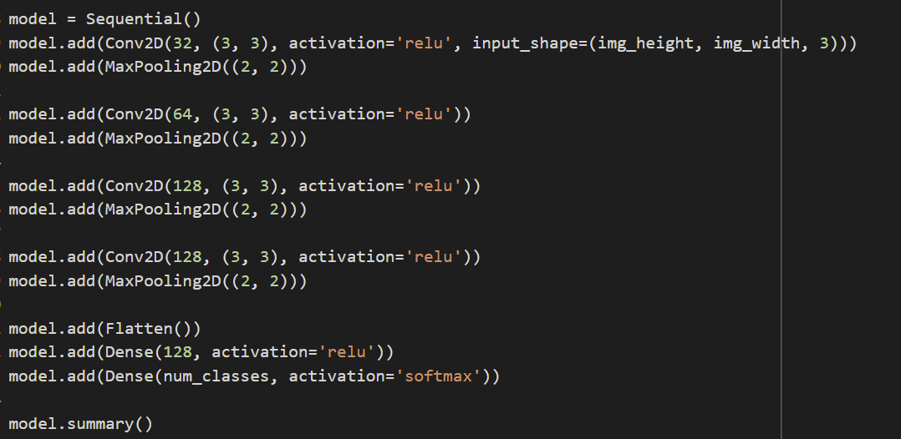
Models
A total of 3 models were implemented:
I. Basic Model

Slide 2
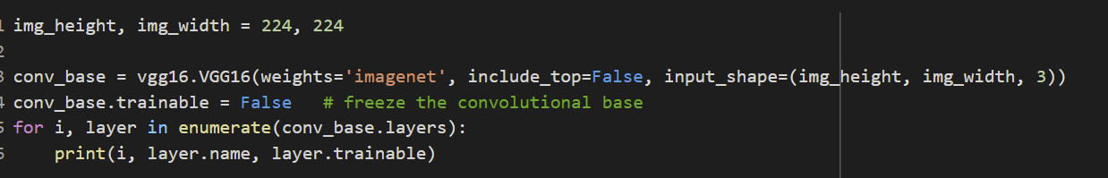
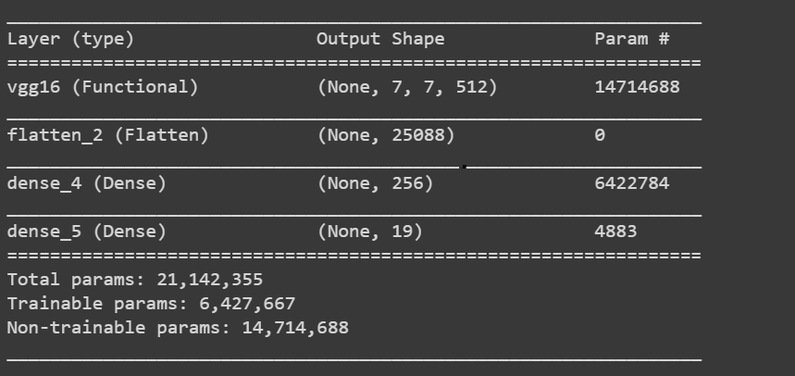
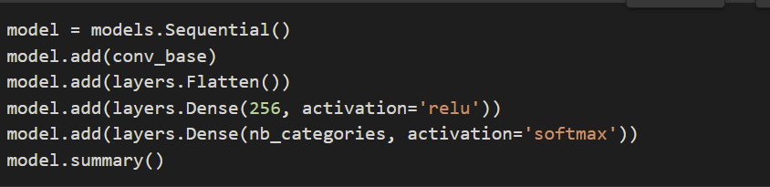
II. Pretrained Model as Feature Extractor
This model was used as feature extractor.
The pretrained model used is VGG16 with the classifier (convolutional layers) frozen.
Then a new classifier composed of FC dense layers was added on top of the feature extractor.

Slide 3
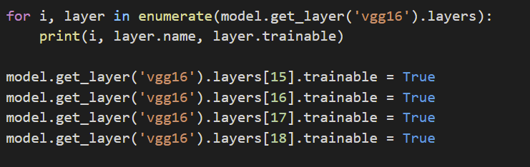
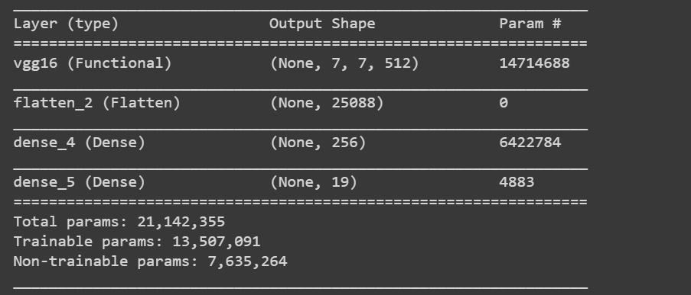
II. Pretrained Model in Fine-Tune Mode
The pretrained model used is VGG16 with top layer frozen.
Step 1:
Then a new classifier composed of FC dense layers was added on top.
Then the model is trained.
Step 2:
Some layers are unfrozen.
Then the model is retrained.

Slide 4
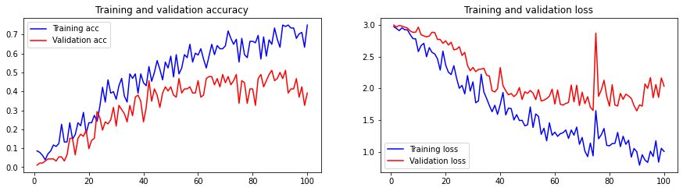

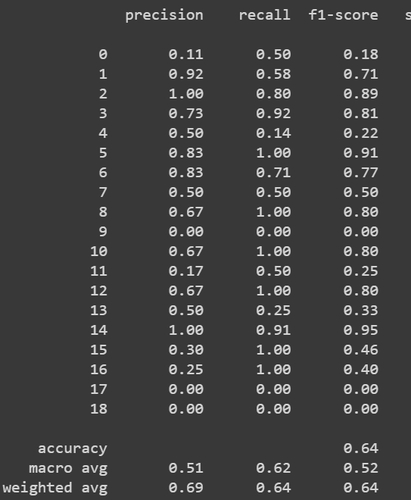
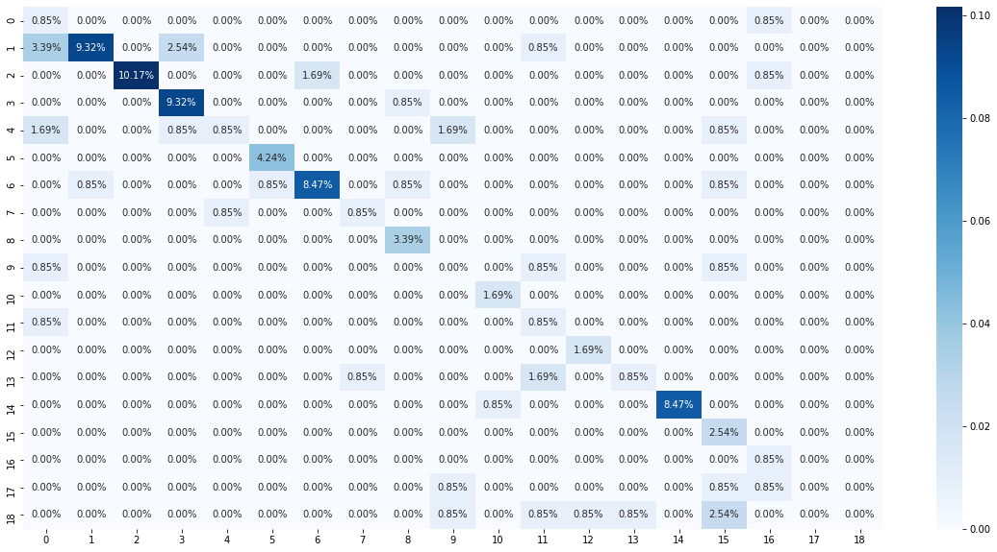
Models Evaluation
1. Basic Model

Slide 5
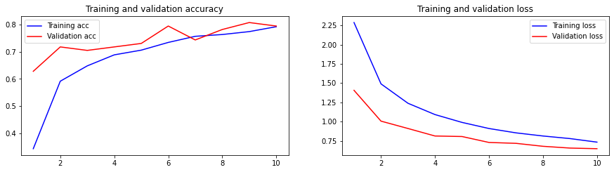

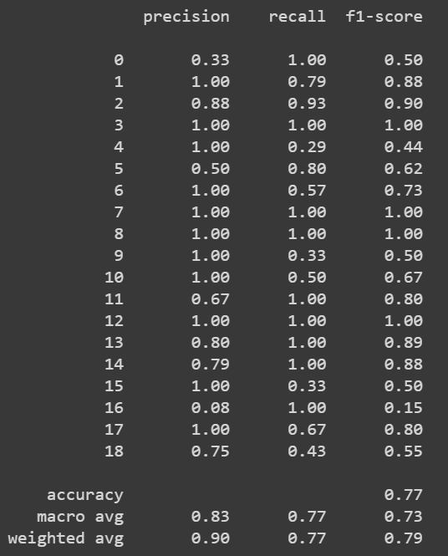
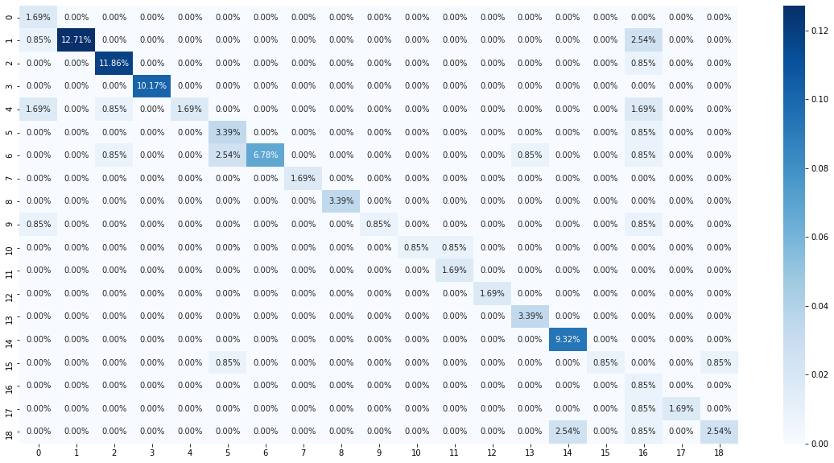
2. Pretrained Model as Feature Extractor

Slide 6
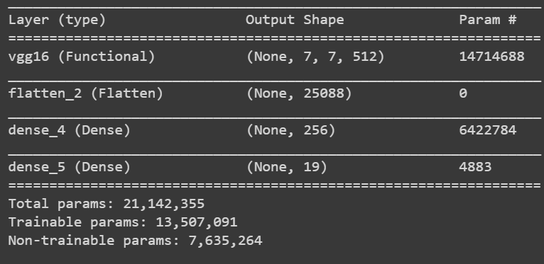
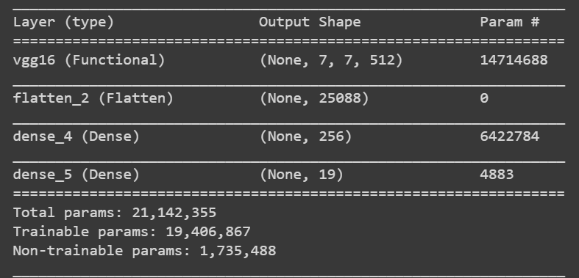
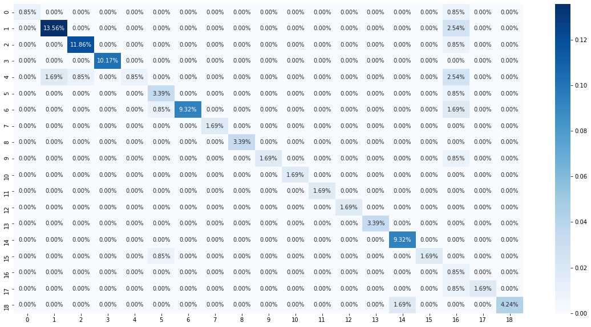
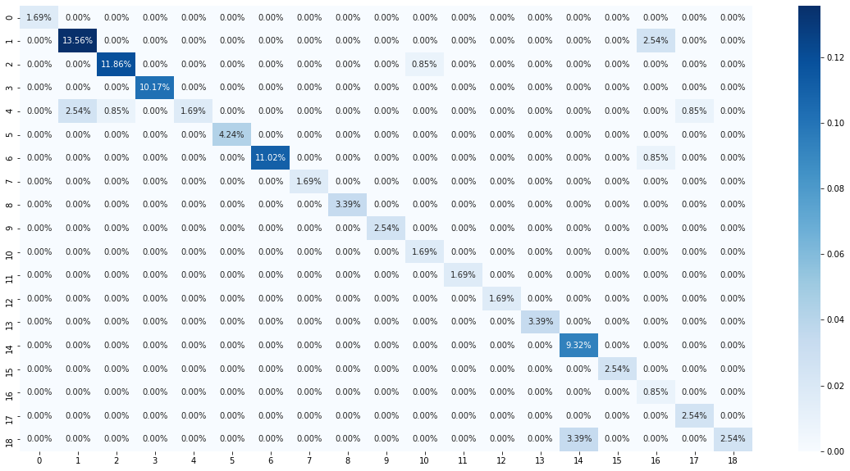
3. Pretrained Model in Fine tune mode

Slide 7
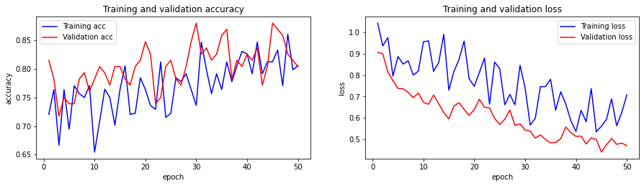

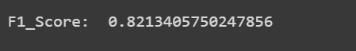
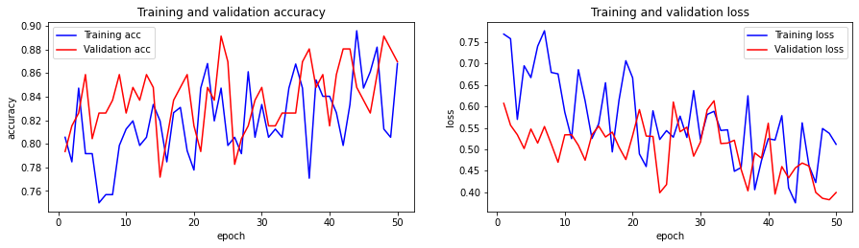


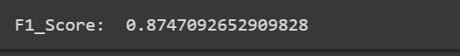
3. Pretrained Model in Fine tune mode con’t

Slide 8
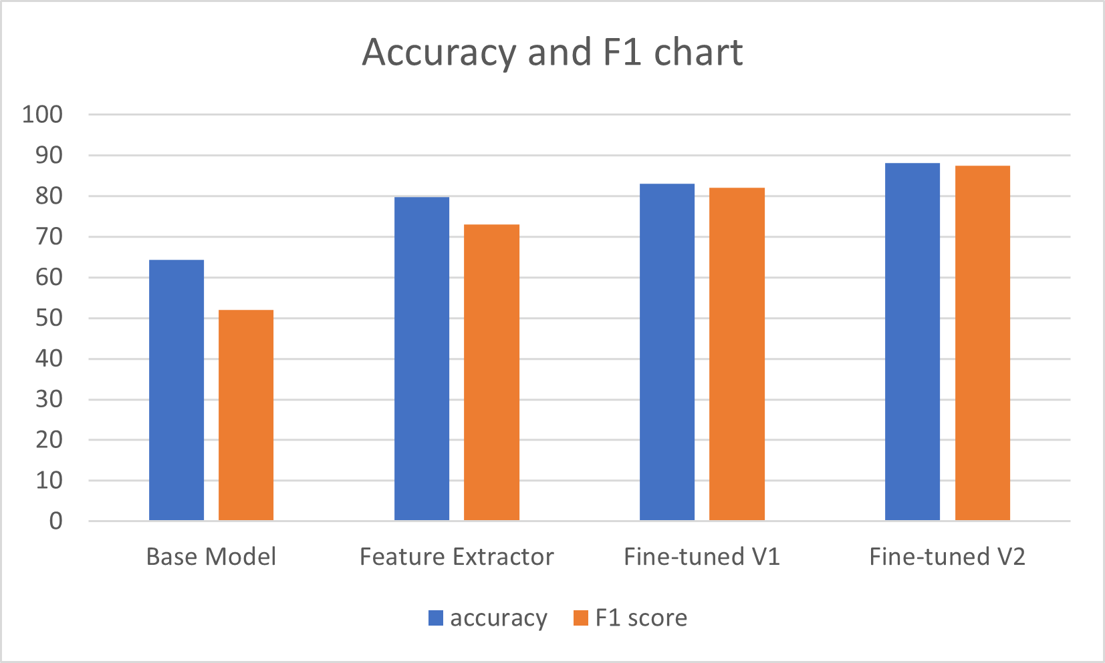
Summary

